Slide 1

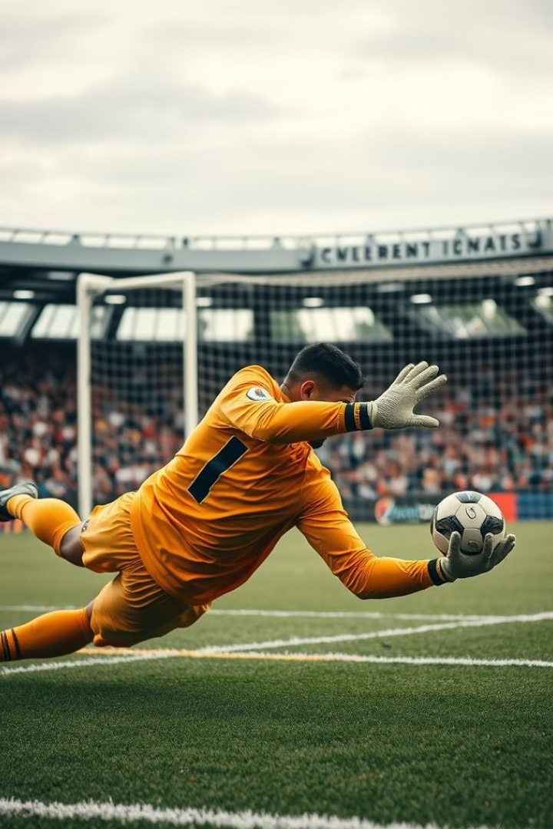
Predicting Penalty Shots
VARSHINI GAYATHRI SURESH - 469038
CARLOS WAN LEE CHAM PEREZ - 470847
ABISHAI SRINIVASAN - 471538

Slide 2
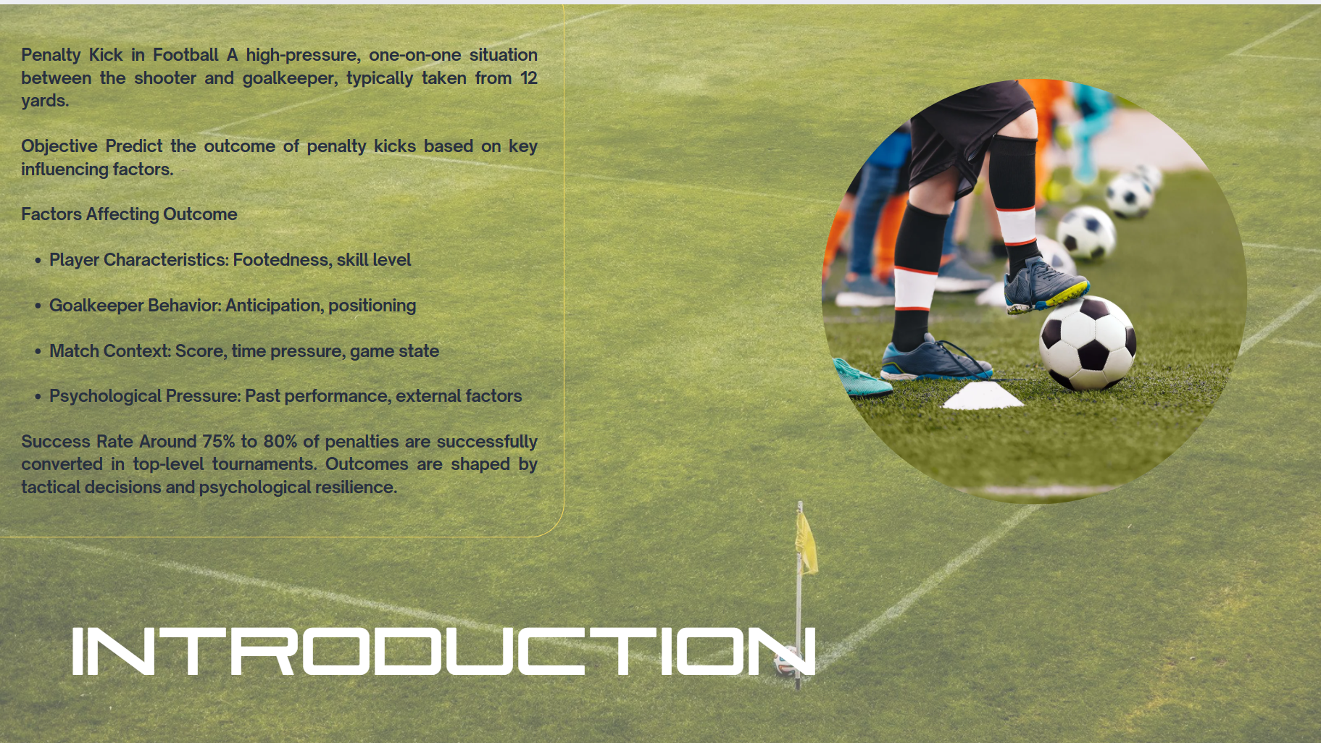

Slide 3





Problem Description
Penalty Kicks
A strategic event where the shooter selects a target spot (e.g., top-left, center-right) while the goalkeeper simultaneously chooses where to dive.
Penalty Shootouts
Used to resolve knockout matches tied after extra time. Key rules include:
Five alternating kicks per team
Sudden death if still tied
Ball must move forward
Goalkeeper must remain on the goal line until the kick
Strategic Decision-Making
Decisions by both shooter and goalkeeper are influenced by psychological, physiological, and match-specific conditions. The limited set of options makes this problem ideal for Discrete Choice Modeling (DCM).
Modeling Approach
Model: Multinomial Logit (MNL)
Alternatives: 6 shot directions (e.g., top-left, bottom-center)
Covariates: Player's dominant foot, goalkeeper's movement, selected direction
Objective: Identify behavioral patterns and assess how goalkeeper actions influence the player's choice

Slide 4
Literature Review – Key Papers
1
Identifying the best strategy for soccer penalty success: A predictive model for optimising behavioural and biomechanical trade-offs
2
The obligation to succeed when it matters the most – The influence of skill and pressure on the success in football penalty kicks
Andrew H. Hunter et al.
Michel Brinkschulte et al.
3
Pressure versus ability: Evidence from penalty shoot-outs between teams from different divisions
4
Penalty kicks as cross-fertilization: On the economic psychology of sports
Ofer H. Azar, Michael Bar-Eli
Alex Krumer
5
Designing practical and fair sequential team contests: The case of penalty shootouts
6
Machine learning-based identification of the strongest predictive features of scoring penalty kick in football
Nejat Anbarcı et al.
Ural Akıncıoğlu et al.

Slide 5
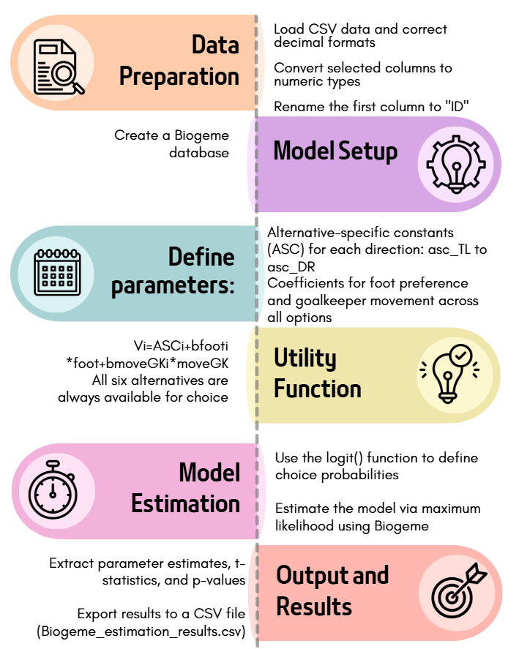
Discrete Choice Modeling Methodology

Slide 6
Parameter | Estimate | Std. Error | t-ratio | Robust Std. Error | Robust t-ratio | p-value
asc_DC | -0,5586 | 0,1508 | -3,7035 | 0,1508 | -3,7035 | 2,13E-04
asc_DL | 0,835 | 0,0907 | 9,2029 | 0,0907 | 9,2029 | 0,00E+00
asc_DR | 1,1884 | 0,0844 | 14,0838 | 0,0844 | 14,0838 | 0,00E+00
asc_TC | -1,2649 | 0,2029 | -6,2352 | 0,2029 | -6,2352 | 4,51E-10
asc_TL | -0,4436 | 0,1461 | -3,0366 | 0,1461 | -3,0366 | 2,39E-03
asc_TR | 0,2437 | 0,1132 | 2,1529 | 0,1132 | 2,1529 | 3,13E-02
RESULTS AND INFERENCE:
Parameter | Estimate | Std. Error | t-ratio | Robust Std. Error | Robust t-ratio | p-value
b_foot1 | 0,3256 | 0,1542 | 2,1116 | 0,1542 | 2,1116 | 3,47E-02
b_foot2 | 0,5476 | 0,2094 | 2,6157 | 0,2094 | 2,6157 | 8,91E-03
b_foot3 | -0,7435 | 0,1323 | -5,6178 | 0,1323 | -5,6178 | 1,93E-08
b_foot4 | 0,2358 | 0,0958 | 2,4623 | 0,0958 | 2,4623 | 1,38E-02
b_foot5 | -0,0387 | 0,164 | -0,2358 | 0,164 | -0,2358 | 8,14E-01
b_foot6 | -0,3269 | 0,0928 | -3,5234 | 0,0928 | -3,5234 | 4,26E-04
Parameter | Estimate | Std. Error | t-ratio | Robust Std. Error | Robust t-ratio | p-value
b_moveGK1 | -0,0685 | 0,0617 | -1,1107 | 0,0617 | -1,1107 | 2,67E-01
b_moveGK2 | 0,0483 | 0,0738 | 0,6538 | 0,0738 | 0,6538 | 5,13E-01
b_moveGK3 | -0,0784 | 0,0644 | -1,2189 | 0,0644 | -1,2189 | 2,23E-01
b_moveGK4 | 0,1221 | 0,0382 | 3,1972 | 0,0382 | 3,1972 | 1,39E-03
b_moveGK5 | -0,0059 | 0,0695 | -0,0852 | 0,0695 | -0,0852 | 9,32E-01
b_moveGK6 | -0,0175 | 0,0393 | -0,4448 | 0,0393 | -0,4448 | 6,56E-01

Slide 7
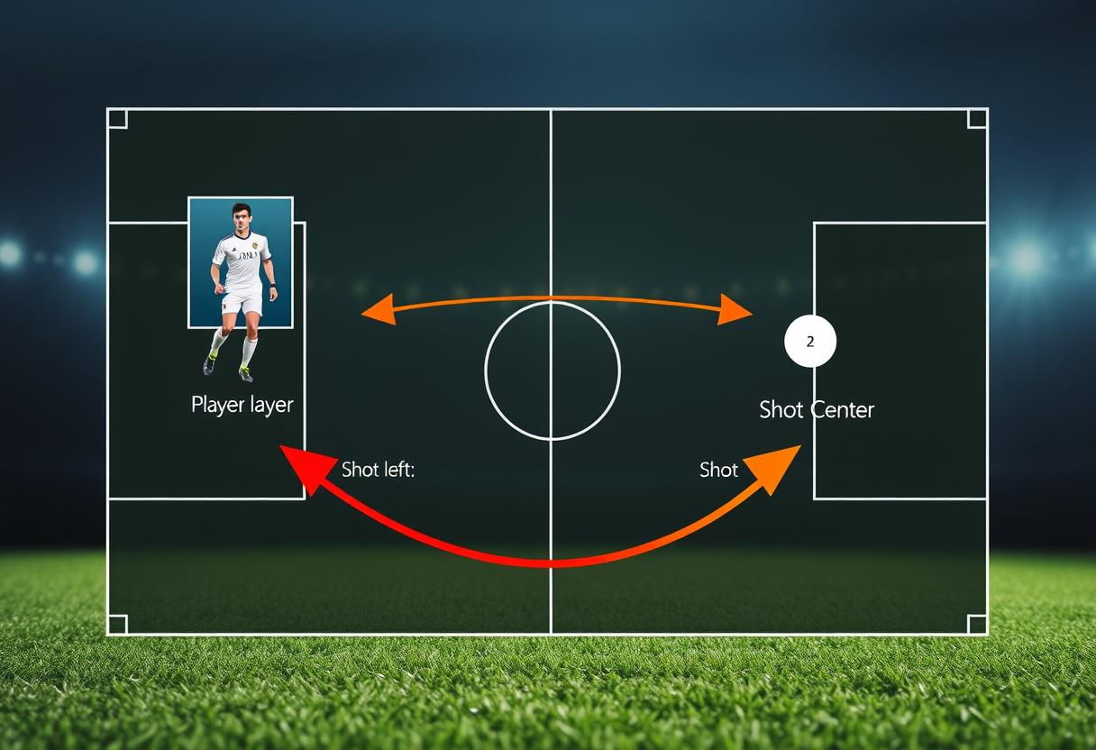
Next Review
Multinomial Logit Model (MNL)
Include all relevant variables (foot, goalkeeper movement, match context, psychological factors) to predict shot outcomes.
Model Testing
Assess model fit using log-likelihood and parameter significance.
Panel Logit Model
Develop a panel logit model for repeated choices, focusing on player and goalkeeper data across multiple kicks.

